Slide 1
Predicting earthquake prone area in a given location using swarm computing

Slide 2
A swarm is a large number of homogenous, simple agents interacting locally among themselves, and their environment, with no central control to allow a global interesting behaviour to emerge.
The agents follow very simple rules, and although there is no centralized control structure dictating how individual agents should behave, local, and to a certain degree random, interactions between such agents lead to the emergence of "intelligent" global behavior, unknown to the individual agents.

Slide 3
The objective of this project is to find an earthquake prone area in a particular region.
Cost function is decided on the basis of factors that can cause earthquake.
Some of the factors affecting earthquake are:
Temperature - At high temperature molecules and their bonds can stretch and move
Confining Pressure - At high confining stress, tend to causing fracture sooner.
Strain rate - At high strain rates material tends to fracture.

Slide 4
Particles are randomly allocated in the problem space. The local best is calculated by comparing the value of cost function of each particle.
In the first iteration this value is assigned to the global best variable also. The velocity of the particles is updated according to the global best value of the cost function and the velocity generation function.
The location of the particles is further updated on the basis of this newly generated velocity. Thus the particles start to converse towards the particle with the highest value of cost function.
After certain iterations, all the articles converse towards the particle with highest value.

Slide 5
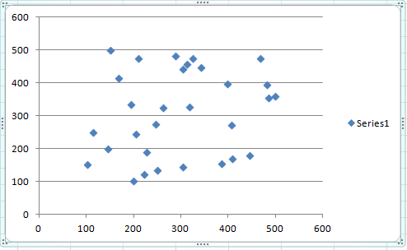

Slide 6
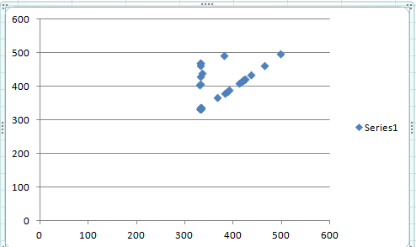

Slide 7
